Slide 1
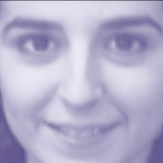
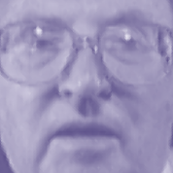


Training set consists of 40 images
For each image
Face image
Face vector
...
64x64
4096x1
Calculate average
face vector
...
Subtract average
face vector from
each face vector
40 face vectors
Notes:
Next, let me show you a real life example that uses PCA for identifying an unknown face.
For this example, I have a training set of 100 images.
Suppose each face image is 50 by 50. that means each face image has 25 hundred pixels or 25 hundred features.
PCA does not work directly for the images, so we need to convert each face image to a face vector that is 2500 by 1.
Suppose each of the blue face vector is 2500 by 1 and represents a face image.
Next step is to find an average face vector by averaging these face vectors, this average face vector will look like this that has the common features of all face images.
Then we will subtract this average vector from each face vector to find the unique feature that defines each face.
This is called face normalization. Each normalized face vector is shown green bars.

Slide 2

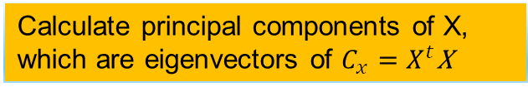
Training set consists of 40 images
Calculate principal components of X, which are eigenvectors of $C_{x}=X^{t}$X
...
4096
4096
...
X=
$$C_{x}=$$
...
...
40
4096
40 face vectors
Notes:
In the X matrix the rows should be samples and column should be features, for this we simply take the transpose of this first matrix.
To find the principal components of the X matrix we need to find the Eigen vectors of its covariance matrix Cx that is 2500 by 2500.
This covariance matrix will yield 2500 principal components.
Note that finding the principal components of this big of a matrix can be computationaly intense and there are easy ways to decrease this computation cost by using linear algebra tricks but this is beyond the scope of this presenttaion., so I will skip.

Slide 3
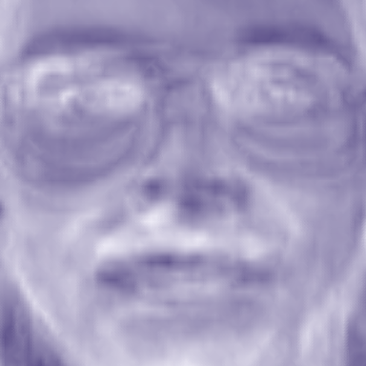
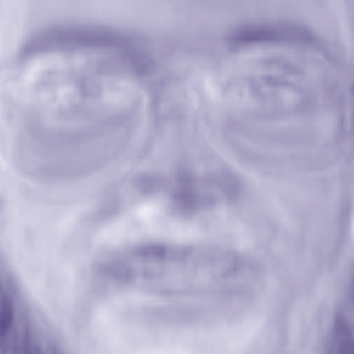
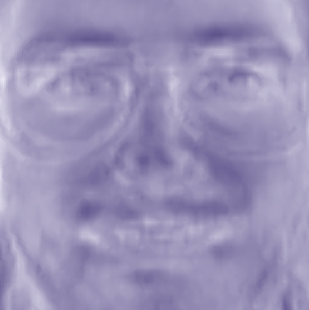
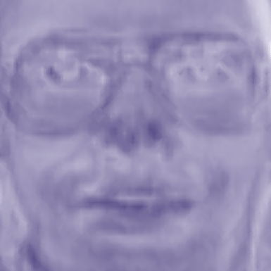
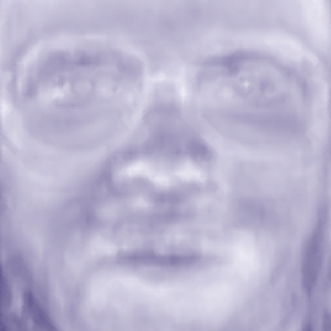
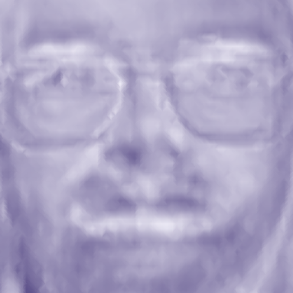
Training set consists of 40 images
...
Select the 6 principal components that have the largest variation
...
...
6 selected principal
components (eigenfaces)
4096 principal components,
each 4096 x 1 dimensional
Notes:
Suppose we found all of the 2500 principal components, suppose first 18 principal components explains the good deal of the variation in the data.
So instead of using all 2500 principal components we decrease the dimensionality, by using only 18 principal components.
Doing this also helps us to remove considerable amount of noise from data.
Notice that for each of the principal component there is a corresponding face image as shown here, we can call these face images as eigen faces, or principal component faces.

Slide 4




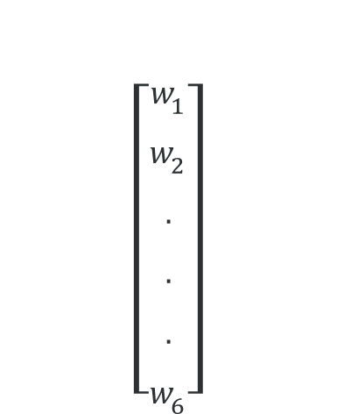

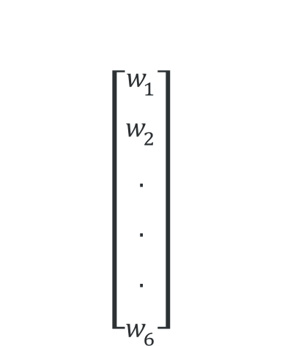
Represent each image in the training set as a linear combination of eigenfaces
$$\left[\begin{aligned}w_{1} \\ w_{2} \\ . \\ . \\ . \\ w_{6}\end{aligned}\right]$$
$$\left[\begin{aligned}w_{1} \\ w_{2} \\ . \\ . \\ . \\ w_{6}\end{aligned}\right]$$
$$w_{1}$$
$$w_{2}$$
$$w_{3}$$
$$w_{6}$$
...
...
Weight vector
for image 1
Weight vector
for image 40
Notes:
Next we will represent each image in the training data as linear combination of eigenfaces.
So for each image in the training data there will be a corresponding weight vector that includes 18 weights. Note that these weight can be found by linear regression.
In the context of dimension reduction, one measure of success here is the degree to which a reduced presentation can predict the original data.
Once you found a weight vector for each of the images in the training data, you can recognize an unknown face by just using these weights.

